Slide 1
Web Scraping with Python
By Jeffrey Wang

Slide 2
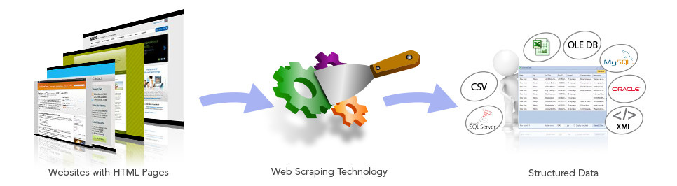
Introduction
What is web scraping?
Why use it?

Slide 3
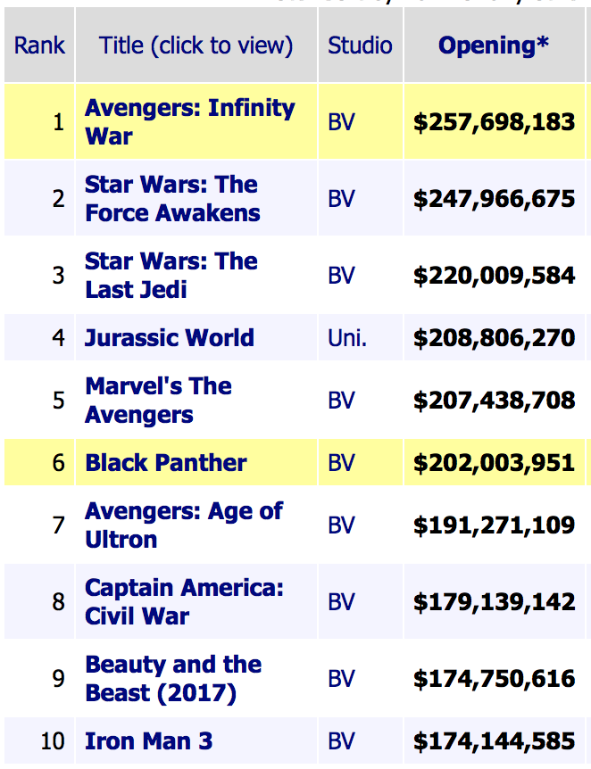
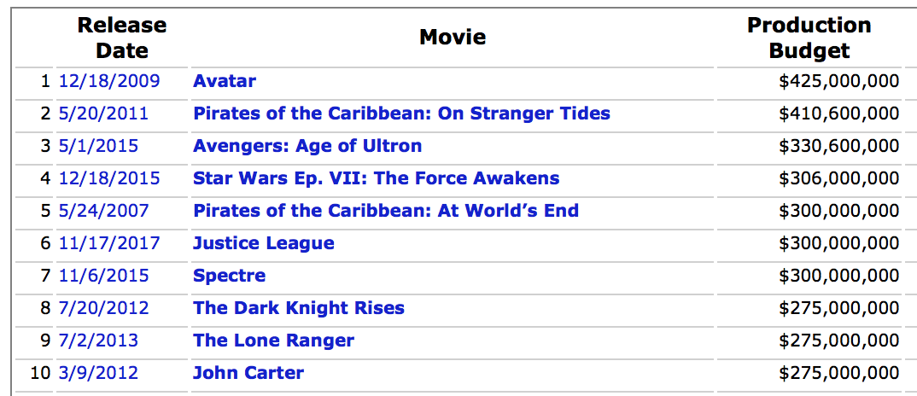
Example Websites
Box Office Mojo - Opening Weekends
The Numbers - Budgets

Slide 4


Getting Started
Urllib
BeautifulSoup

Slide 5
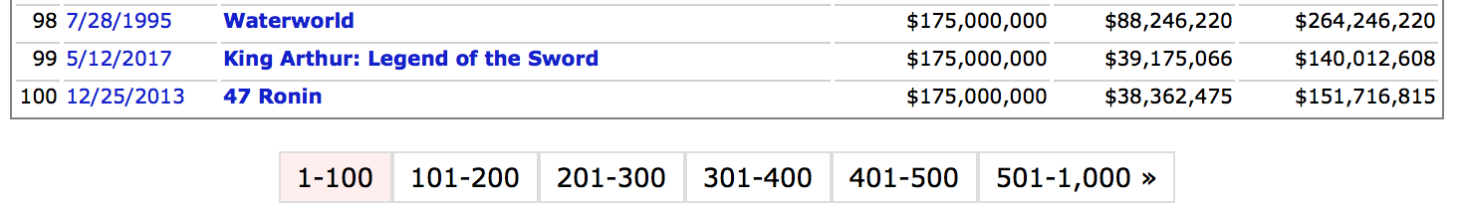
Opening the Web Pages
Need to loop over all the web pages
Use Urllib to fetch each web page

Slide 6
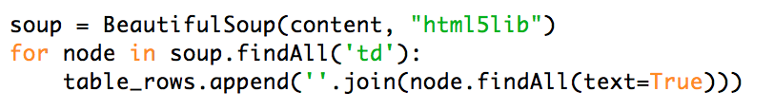
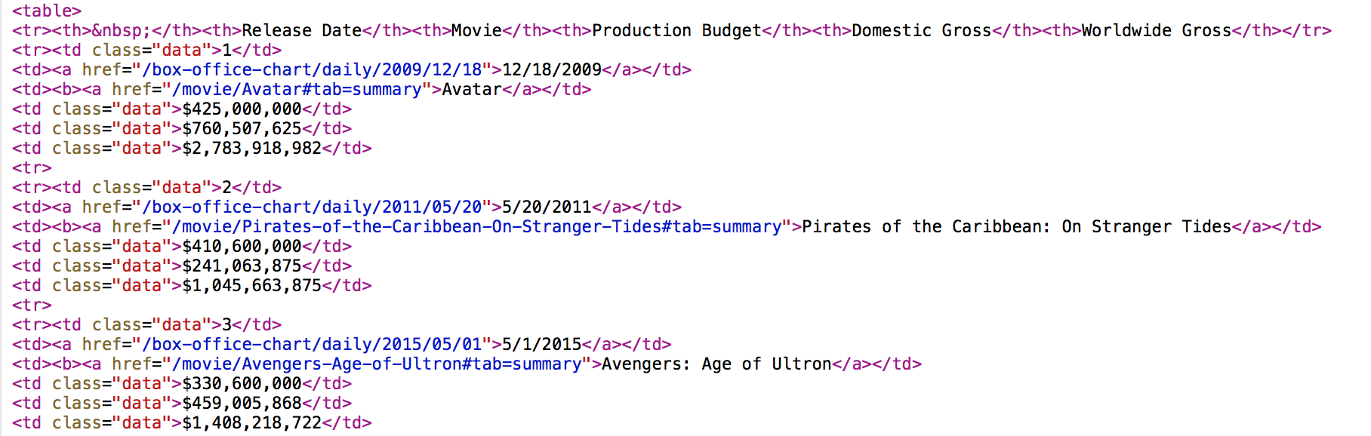
Retrieve and Store Table Data
Create BeautifulSoup object
Use findAll function (locate all <td> tags)
Store data from <td> tags in array

